Slide 1
ONLINE CONSULTATIONS
MFINE APP | AVANTEL APP ( ImedsLife App)
OTP AUTHORIZATION | OTP AUTHORIZATION
SYMPTOMS COLLECTION( ONLY ACCPET 2) | SYMPTOMS COLLECTION( ACCEPT MULTIPLE)
SYSTEM ASK USER IF SELF OR FAMILY MEMBER AFTER SELECTION OF DOCTOR | SYSTEM WILL ASK DOCTOR WETHER FAMILY MEMEBR OR SELF AT STARTING .
SYSTEM COLLECTS SYMPTOMS BASED ON category WISE (29 categorys) | SYSTEM COLLECTS SYMPTOMS BASED ON category WISE
Based on symptoms doctors profiles will be shown | Based on symptoms doctors profiles will be shown
FILTERS ARE AVAIBLE ON experience,language,doctors fees, location,availability, speciality, gender hospital. | Filters available on Languages known Yrs of experience ,Specialization ,Consultation fee ,Location ,Rating of doctor,Hospital ,gender
In sort options earliest doctors available | sort option contains earliest availabity doctors.
Message will get pop up when doctors consulation is fixed . | Message will get pop up when doctors consulation is fixed .

Slide 2
MFINE APP | AVANTEL APP(IMEDS Life APP)
At present the chat will be handle by the chatbot and chatbot will take the details of patient and medical reports and after payment the doctor will be notified . | After the payment the consultation will be booked. Before the ChatBot will handle the details of the patient .
VIDEO, CHAT are available | Video(default), audio,chat are available
The doctor doesn’t have any option of blocking consultations | The doctor shall be able to block time slots, dates for avoiding consultations.
Patient can not see weather doctor is in offline or online . | Patient can see weather doctor is in offline or online.
The consultation can be seen in the dashboards. | Consultations time and date will be updated for both doctor and patient in their Dashboards
The Video call is only avaible . | If video quality is very poor, the system shall stop video and voice shall continue
 | The case study shall be available to both doctor & patient which will be directly stored in the Dashboards.
 | The consultation room may be ended by patient or doctor

Slide 3
MFINE APP | AVANTEL APP(IMEDSLIFE APP)
The cancellation policy is present | The consultation amount shall be returned to the patient based on cancellation policy
 | If patient wants to change doctor, difference amount shall be payable
 | If diagnostic tests are prescribed, the system shall display Search Lab button.
 | The report shall be exported to PDF and shared
 | The system shall assign a unique alpha numeric word for identifying each consultation
 | The system shall store patient details, prescriptions, messages etc locally on the device also
Offers Are available on consultation fees ex : promo code etc.,

Slide 4
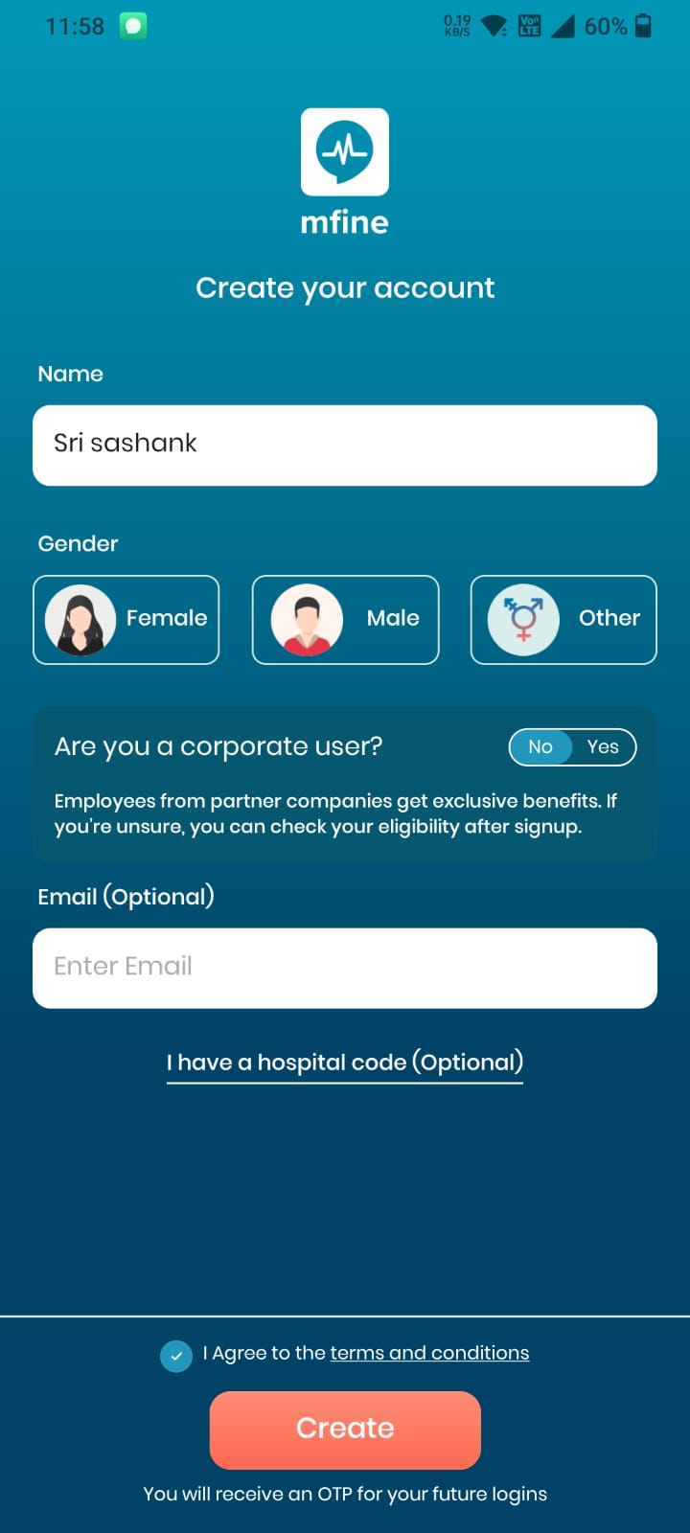
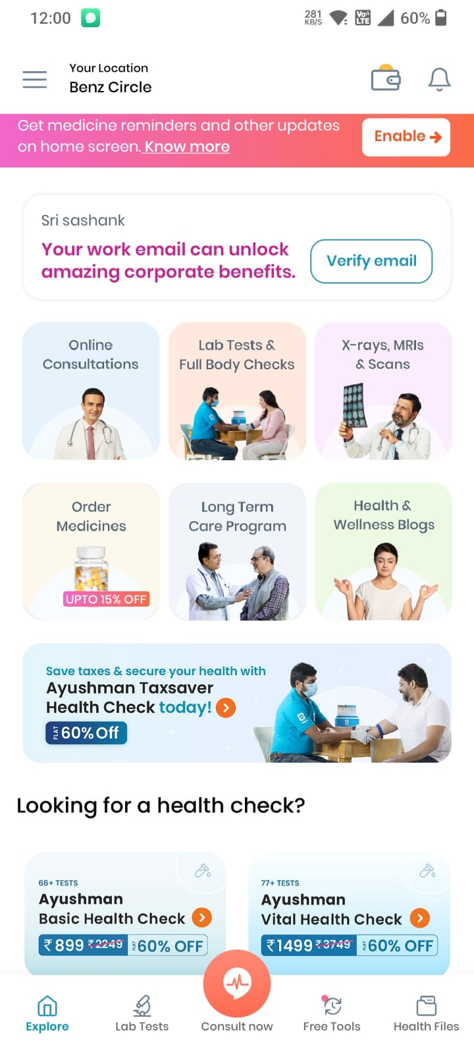
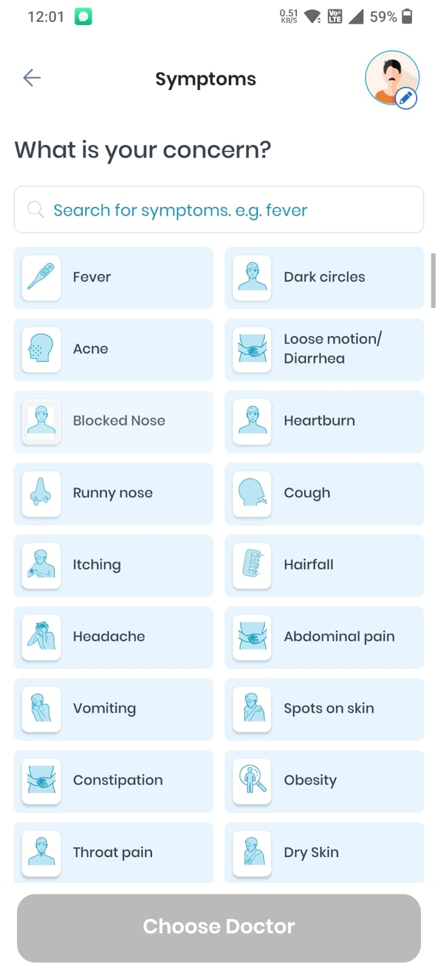
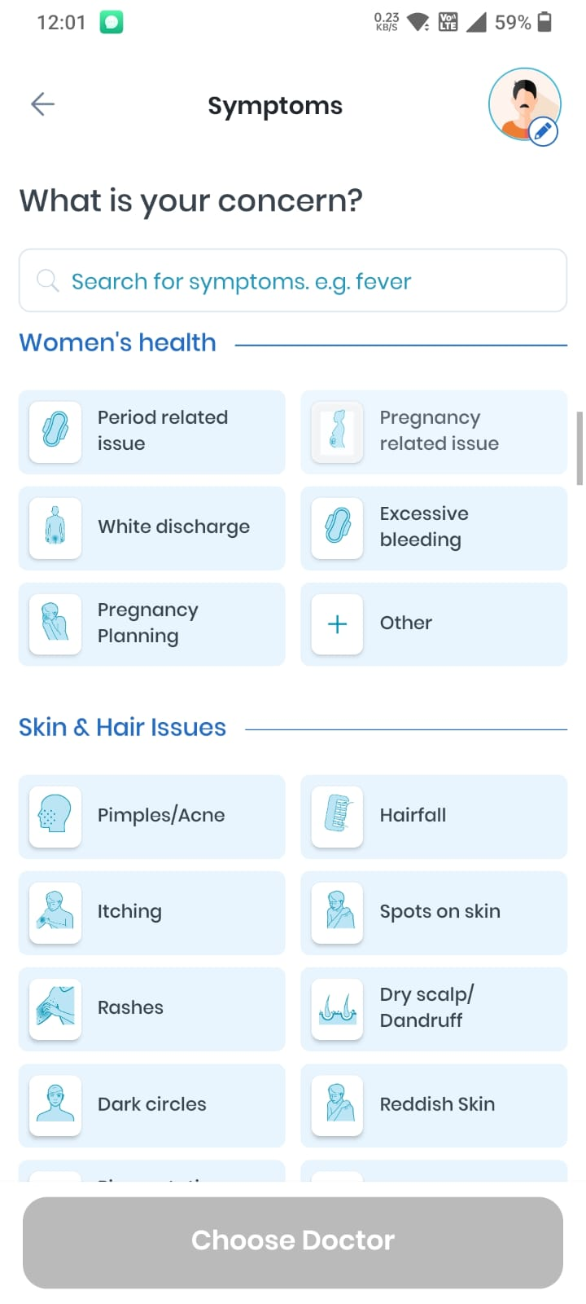
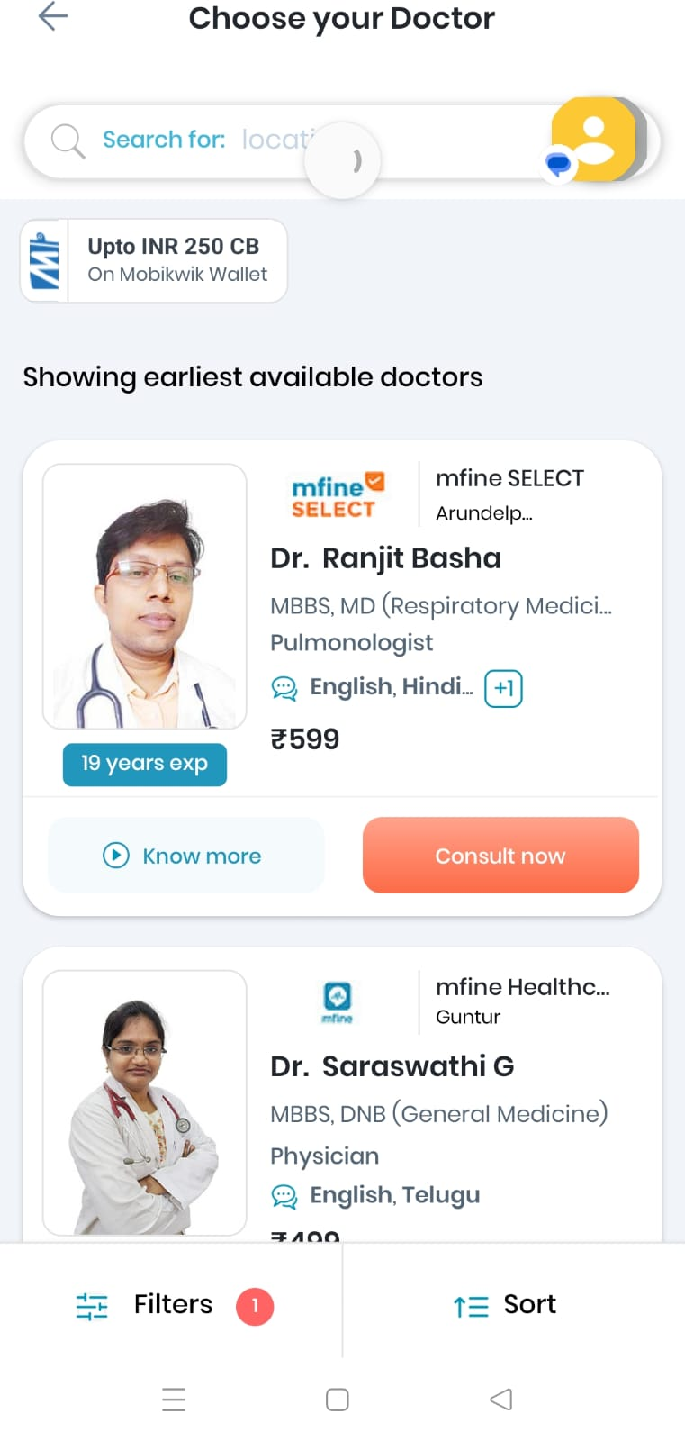
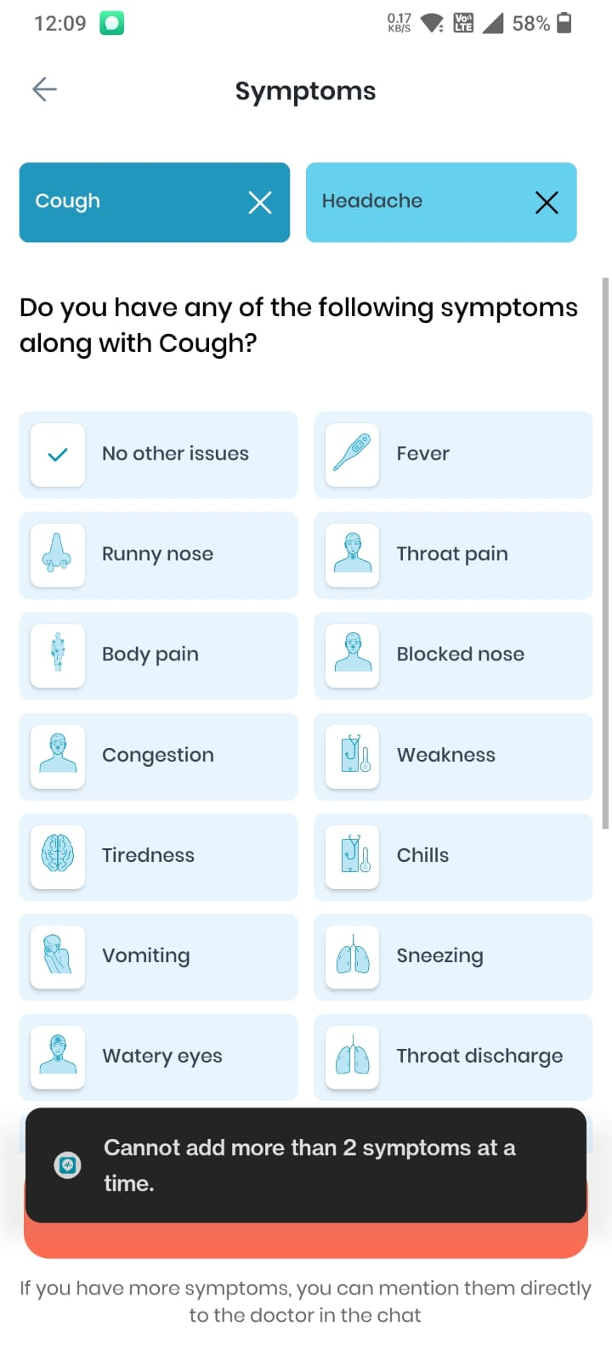
Online Consultation
OTP
29 categories(2 symptoms can be selected)
CONSULT NOW

Slide 5
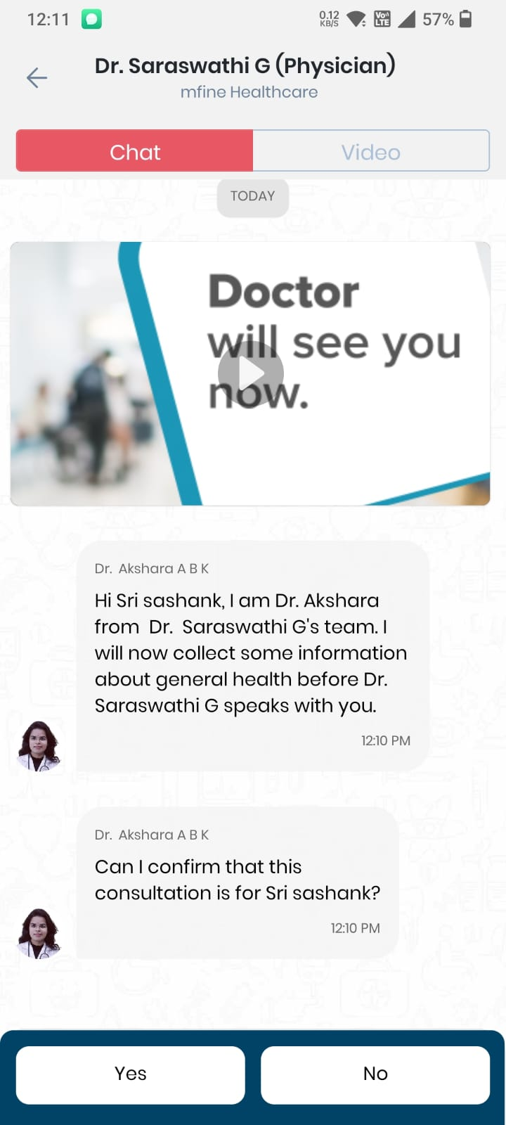
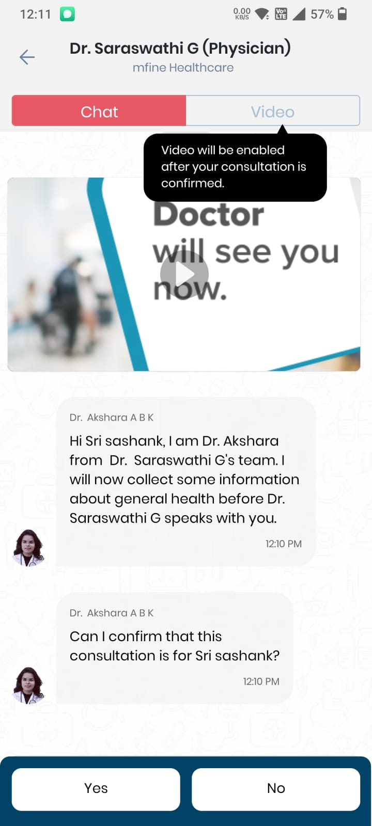
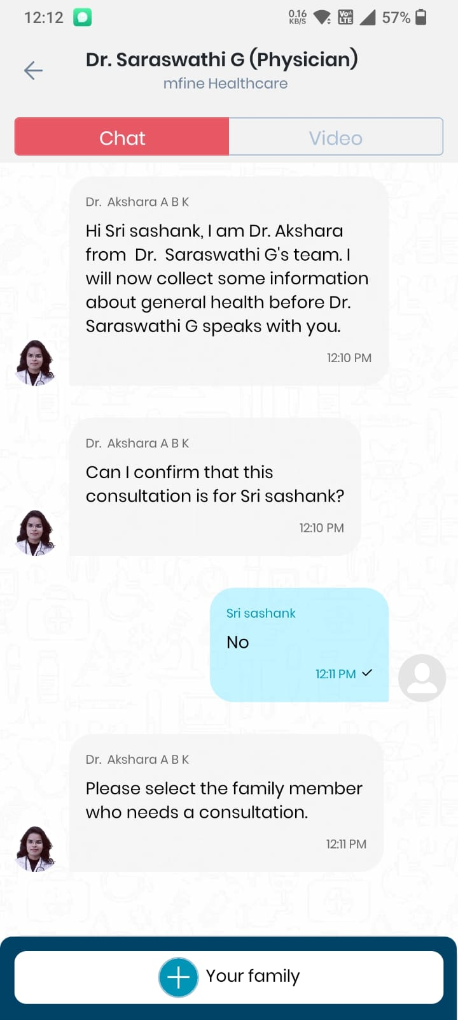
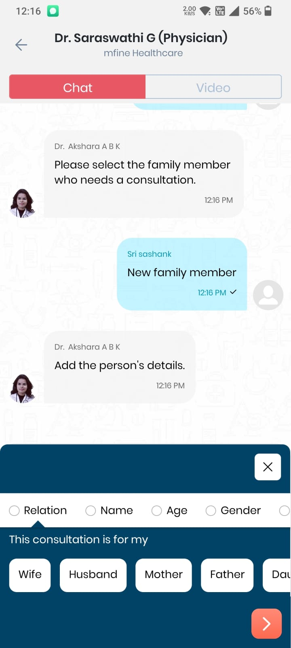
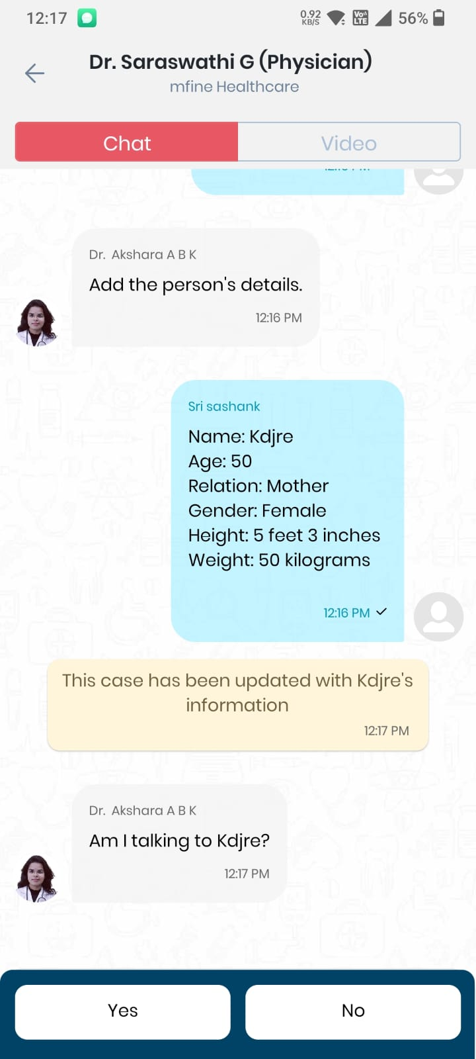

Slide 6
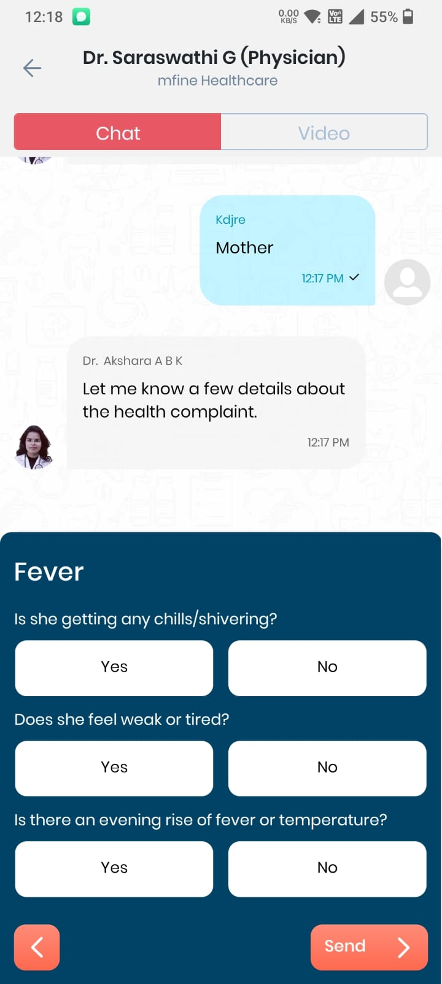
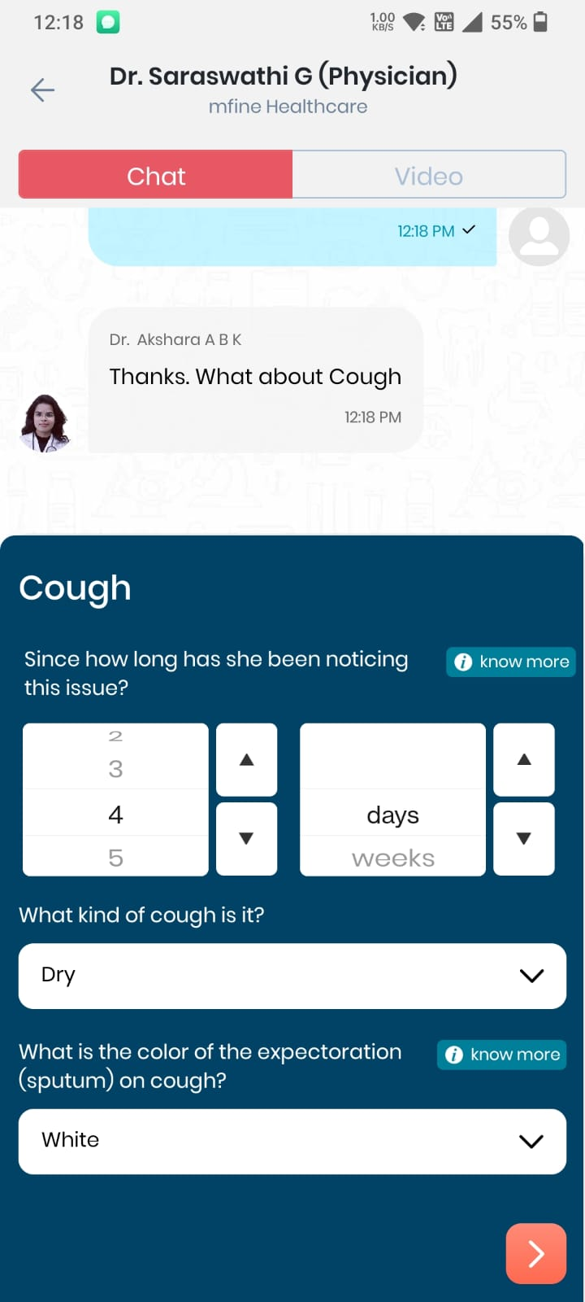
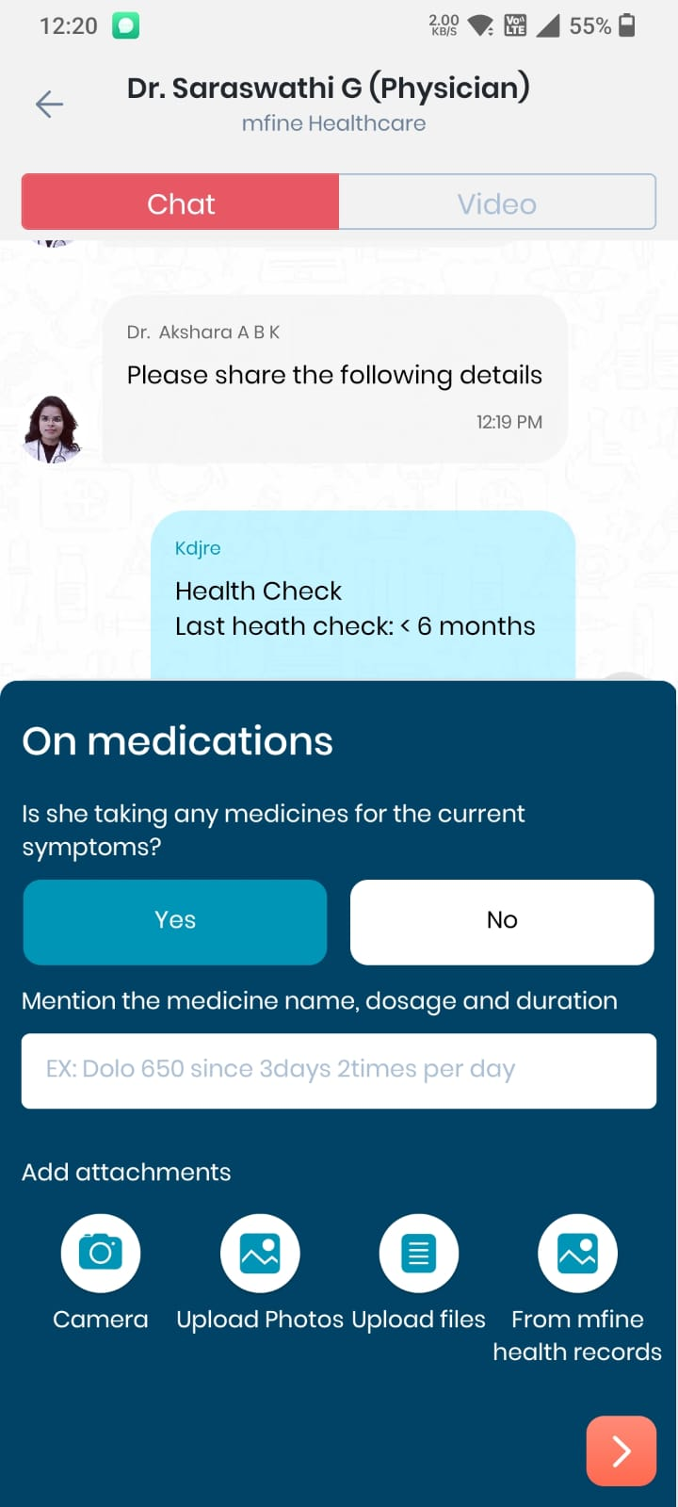
BASED ON SYSMPTOMS THE DATA WILL BE COLLECTED BY THE CHAT BOT
If Any files need to be uploaded

Slide 7
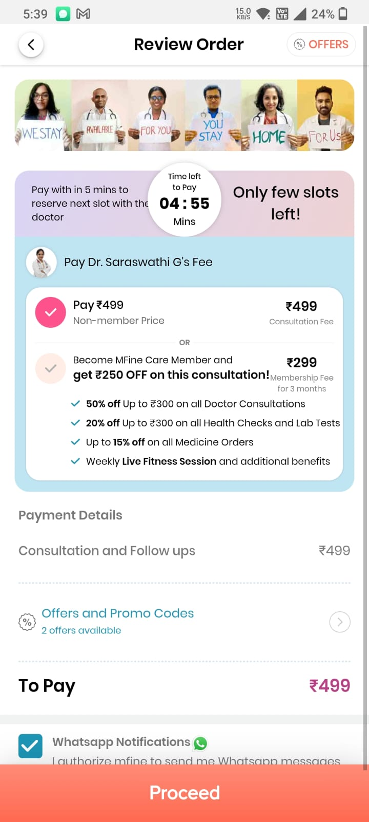
AFTER COLLECTING DETAILS PAYMENT PROCESS WILL BE DONE
CONSULTATION ROOM WILL BE OPENED

